Slide 1

FACIAL EMOTION DETECTION USING CONVOLUTIONAL NEURAL NETWORKS BY COMPUTING IMAGE EDGES
DEPARTMENT OF COMPUTER SCIENCE AND ENGINEERING
Under the guidance of
Mr. V. Siva Prasad, M.Tech Assistant Professor, Department of CSE, Sree Vidyanikethan Engineering College, Tirupati
By
S HEMA (18121A05K8) S HEMANTH(18121A05K9) S MADHURI (18121A05L3) S RAKESH (18121A05L5)
S BHARATH REDDY(18121A05L6)

Slide 2
INDEX
Abstract
Introduction
Problem Statement
Objective
Hardware and Software Requirements
Existing System
Software Requirement Specification
Proposed System
Approach
UML Diagrams
References

Slide 3
ABSTRACT
Human emotion recognition plays an important role in the interpersonal relationship. Emotion detection from image is one of the most powerful and challenging research task in social communication. The automatic recognition of emotions has been an active research topic from early eras. Therefore, there are several advances made in this field. Emotions are reflected from speech, hand and gestures of the body and through facial expressions. Hence extracting and understanding of emotion has a high importance of the interaction between human and machine communication. When it comes to image processing, deep learning (DL)-based emotion recognition outperforms classical methods. This paper proposes a face expression identification approach based on a convolutional neural network (CNN) and image edge detection to avoid the complex process of explicit feature extraction in traditional facial expression recognition. The edge of each layer of the image is retrieved in the convolution process after the facial expression image is normalised. To maintain the texture picture's edge structure information, the retrieved edge information is placed on each feature image. The maximum pooling method is then used to reduce the dimensionality of the extracted implicit features. Finally, a Softmax classifier is used to classify and recognise the expression of the test sample image.

Slide 4
INTRODUCTION
Emotion is a mental state associated with the nervous system associated with feelings, perceptions, behavioural reactions, and a degree of gratification or displeasure.
One of the current application of artificial intelligence (AI) using neural networks is the recognition of faces in images and videos for various applications.
Most techniques process visual data and search for general pattern present in human faces in images or videos.
Face detection can be used for surveillance purposes by law enforcers as well as in crowd management.
This paper presents a method for identifying seven emotions such as anger, disgust, neutral, fear, happy, sad, and surprise using facial images.
Human-computer interaction technology refers to a kind of technology which takes computer equipment as the medium, so as to realize the interaction between human and computer.

Slide 5
INTRODUCTION
It has been applied in the fields of assistant medicine, distance education, interactive games and public security.
Under the trend of artificial intelligence, the communication between human and computer becomes easier and easier.
The facial expression recognition is also applied to the medical field. To know the effect of new antidepressants, more accurate drug evaluation can be made according to the daily record of patients’ facial expressions.
It helps to interpret the emotions of autistic children and help doctors understand the psychological changes in them.
It can be used in traffic field to judge the fatigue state of pilots or drivers.

Slide 6
PROBLEM STATEMENT
The scientific study have been made by many organizations on human sociology identifies the real importance of the human emotion in each and every sector. So if we understand the human emotions automatically it will help us to process more accurately and efficiently. Improving the skills of reading expressions is an important step towards successful relations. Recognizing the facial expressions which are considered universal among all walks of cultures like anger, disgust, neutral, fear, happy, sad, and lastly surprise, by image edge computing unlike traditional methods that work on feature extraction and consume more time. And building a model based on Convolutional Neural Networks (CNN) that helps in detecting and classifying the emotions through weighted assumption of the facial emotions of a person.

Slide 7
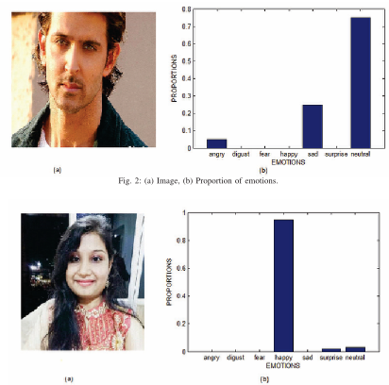
PROBLEM STATEMENT
Fig. 3: (a) Image, (b) Proportion of emotions

Slide 8
OBJECTIVE
Building a model that uses the deep learning (DL) open library “Keras” for recognizing facial emotions of a person.
The model should use Haar Cascade classifier in order to detect the faces and to compute the facial edges and AdaBoost alogorithm is to be applied to enhance the classifier.
The Eigen values for the Haar-like features are to be calculated using integral graphs. The input images are to be pre-processed first and executed by the model.
As part of pre-processing, firstly the images are scaled to a specific size and they are normalized to enhance the contrast or its gray level equalization using Histogram Equalization method.
Image edges are to be computing using Kirsch Edge operator.

Slide 9
OBJECTIVE
The main objective is that the model should be able to detect seven different types of emotions like anger, disgust, neutral, fear, happy, sad, and lastly surprise.
So the model is to be trained on the basis of FER-2013 dataset that is split into training data and test data. The image data is to be sent through various layers of convolutional neural networks.
Besides working with convolutional layers the data should be sent through maximum pooling layer for dimensionality reduction simultaneously applying ReLU function to avoid the problem of overfitting.
The resulting data need to be sent through full connection layer and Softmax layer for final classification of emotions.

Slide 10
SYSTEM SPECIFICATIONS
HARDWARE SPECIFICATIONS:
Processor : I5/Intel Processor
RAM : 8GB (min)
Hard Disk : 128 GB
SOFTWARE SPECIFICATIONS:
Operating System : Windows 10
Server-side Script : Python 3.6
IDE : Jupyter notebook / Google Colab
Libraries Used : Numpy, IO, OS, Flask, keras, pandas,
FER(Face Emotion Recogniser)

Slide 11
EXISTING SYSTEM
The research of expression recognition in computer field mainly focuses on the feature extraction and feature classification. There are many methods of feature extraction.
According to the type of data input, the existing methods of feature extraction can be divided into two categories: one is based on static images and the other is based on a dynamic sequence.
Feature extraction methods based on static images include Gabor wavelet transform, Haar wavelet transform, Local Binary Pattern (LBP), and Active Appearance Models (AAM).
Generally speaking, the dimension of feature is large before and after the completion of feature, and thus the dimension reduction is usually carried out.
Commonly used methods of facial expression classification are Hidden Markov Model (HMM), Support Vector Machine (SVM), AdaBoost, and Artificial Neural Networks (ANN).

Slide 12
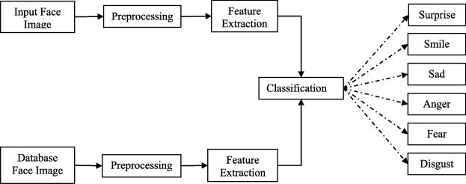
EXISTING SYSTEM
The traditional method for emotion detection includes three steps. They are preprocessing, feature extraction and classification

Slide 13
6.1 Preprocessing:
Image preprocessing includes different types of processes such as image clarity and scaling, contrast adjustment, and additional enhancement process to improve the expression frames.
The cropping and scaling processes were performed on the face image in which the nose of the face is taken as midpoint and the other important facial components are included physically.
The Gaussian filter is used for resizing the input images which provides the smoothness to the image.
Normalization is the preprocessing method which can be designed for reduction of illumination and variations of the face images with the median filter and to achieve an improved face image.
It is also used for the extraction of eye positions which make more robust to personality differences for the FER(Facial Emotion Recognition) system and it provides more clarity to the input images.

Slide 14
6.2 Feature extraction:
Feature extraction process is the next stage of FER system. Feature extraction is finding and depicting of positive features of concern within an image for further processing.
In image processing computer vision feature extraction is a significant stage, whereas it spots the move from graphic to implicit data depiction.
Then these data depiction can be used as an input to the classification.
The feature extraction methods are categorized into five types such as texture feature-based method, edge based method, global and local feature-based method, geometric feature-based method and patch-based method.
The traditional methods are mostly based on texture feature and global and local features.

Slide 15
6.2 Feature extraction:
An image texture is a set of metrics calculated in image processing designed to quantify the perceived texture of an image.
Some of the filters used for texture synthesis are as follows.
Gabor Filter: It analyzes whether there is any specific frequency content in the image in specific directions in a localized region around the point or region of analysis.
Local Binary Pattern : It is a simple yet very efficient texture operator which labels the pixels of an image by thresholding the neighbourhood of each pixel and considers the result as a binary number.
Principal Component Analysis: It is based on global and local features. It summarize the information content in large data tables by means of a smaller set that can be more easily visualized and analyzed.

Slide 16
6.3 Classification:
Classification is the final stage of FER system in which the classifier categorizes the expression such as smile, sad, surprise, anger, fear, disgust and neutral. Some of the methods are:
Support Vector Machine (SVM): It constructs a hyperplane in multidimensional space to separate different classes. The core idea of SVM is to find a maximum marginal hyperplane(MMH) that best divides the dataset into classes. Emotion classification can be done in two ways
One against one
One against all
Hidden Markov Models(HMM): The image is divided into blocks. Each block consists of two dimensional feature vector which is used for classifying the block. Finally the class with maximum posteriori probability is considered.

Slide 17
SOFTWARE REQIREMENT SPECIFICATION
Introduction
Purpose:
The purpose of this document is to present a detailed description of the Facial emotion recognition using Convolutional Neural Networks. In this project a new approach is described which classifies the expressions with the help of image edge computing. Besides classifying facial emotions, this model requires lesser training time with more accuracy and robustness unlike traditional methods that uses feature extraction.
Scope of the Project:
The model designed will be used for recognizing seven types of facial expressions that are considered as universal among all walks of cultures. They are anger, disgust, neutral, fear, happy, sad, and lastly surprise. Facial expression recognition systems run with an objective of understanding and analyzing the true perceptions of people with the help of their expressions.

Slide 18
SOFTWARE REQIREMENT SPECIFICATION
General description
The main theme of the project is to detect and classify the emotions of a person. Facial expression emotion recognition is an intuitive reflection of a person’s mental state, which contains rich emotional information, and is one of the most important forms of interpersonal communication. In this project a model is build to which facial images are given as input. The file name and its path of these images are taken by the source code to access the images in that address. This is done using a Webpage in which user upload the image. Once the execution is completed the bar charts are displayed as output that describes the classification of emotions.
Functional Requirements
Jupyter Notebook: The source code for this model needs to be executed in either Jupyter Notebook or Google Colab. Jupyter Notebook provides a simple platform for executing python programs. It also provides various tools that can help to import the python files from local disk and execute them whenever necessary.

Slide 19
SOFTWARE REQIREMENT SPECIFICATION
Google Colab: It is a product from Google Research. Colab allows anybody to write and execute arbitrary python code through the browser, and is especially well suited to machine learning, data analysis and education. The main advantage of Google Colab is that it provides free GPU (Graphics Processing Unit) and some other additional tools.
Python Programming language: We use python to design the model that works on Convolutional Neural Networks. This program consists of various python libraries like “Keras”, “matplotlib”, “tensorflow” etc,.
Webpage: This is where the images are uploaded and taken as input. The webpage consists of an “Upload” button through which the images are stored into the database. The uploaded image is analyzed and facial expressions present in it are classified and displayed as a bar chart.
Database: To store the image data some of the local disk memory is provided. The webpage is linked to this database. So the images uploaded in the webpage are directly sent to this database for storing.

Slide 20
SOFTWARE REQIREMENT SPECIFICATION
Nonfunctional requirements
Usability: This model can be used by anyone through the designed webpage. The page is very simple to use for anyone who knows a little English vocabulary. The user does not need to understand any of the concepts in the source code. They just need to upload their facial images to know the weighted comparison of different expressions present in their faces.
Availability: This project can be used by anyone anytime without any constraints or restrictions. The webpage can be accessed by anybody who is willing to understand and classify various expressions present in the facial images.
Reliability: This model is quite efficient when compared to the traditional methods with less accuracy rates around 65%. The proposed model runs with an average accuracy rate of around 80%. Even training time is less when compared to other methods. The main advantage of this model lies in its performance and accuracy.

Slide 21
SOFTWARE REQIREMENT SPECIFICATION
Robustness: This model is efficient even when the facial images are fuzzy. It provides accurate results and detects faces clearly in various types of backgrounds. To increase the robustness the model is trained with the scientific mixture of two datasets ie, Fer- 2013 and LFW. And to know the standards of this model its reliability factor is compared to algorithms like FRR-CNN and R-CNN.
System specifications
Hardware specifications:
Network connectivity.
Minimum 4GB RAM is required.
i5/ Intel Processor
Graphic Card is required.
Software specifications:
Operating System : Windows 10
Server-side Script : Python 3.6
IDE : Jupyter notebook, Google Colab
Libraries Used : Numpy, Flask, keras, pandas, FER(Face Emotion Recognizer)

Slide 22
PROPOSED SYSTEM
To avoid the complex process of explicit feature extraction in traditional facial expression recognition, a facial expression recognition method based on CNN and image edge detection is proposed in this paper. The main innovations of this method are as follows:
The edge of each layer of the input image is extracted, and then the extracted edge information is superimposed on each feature image to preserve the edge structure information of the texture image.
In this paper, the maximum pooling method is used to reduce the dimension of the extracted implicit features, which shortens the training time of the convolutional neural network model.

Slide 23
PROPOSED SYSTEM
The difference between the proposed system and the existing system is that the concept of image edge computing is included in this model.
The facial emotions are detected and classified using these edge information.
Firstly, we locate the face in the image and cut out the face image.
Then, we normalize the face image to a specific size.
Next, we equalize the histogram of the image to reduce the influence of illumination and other factors.
Finally, we extract the edge of each layer of the image in the convolution process.

Slide 24
A. FACE DETECTION AND LOCATION:
This paper uses a Haar classifier for human detection.
The Haar classifier is trained by Haar-like small features(linear, edge, center and diagonal) and an integral graph method combined with the AdaBoost algorithm.
This method uses the Haar-like to extract facial features, and uses an integral graph to realize fast calculation of Haar-like features.
However, the calculation of eigenvalues is very time-consuming.
In order to improve the calculation speed, this paper uses the integral graph method to calculate the Haar like eigenvalues.

Slide 25
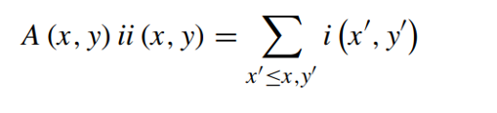
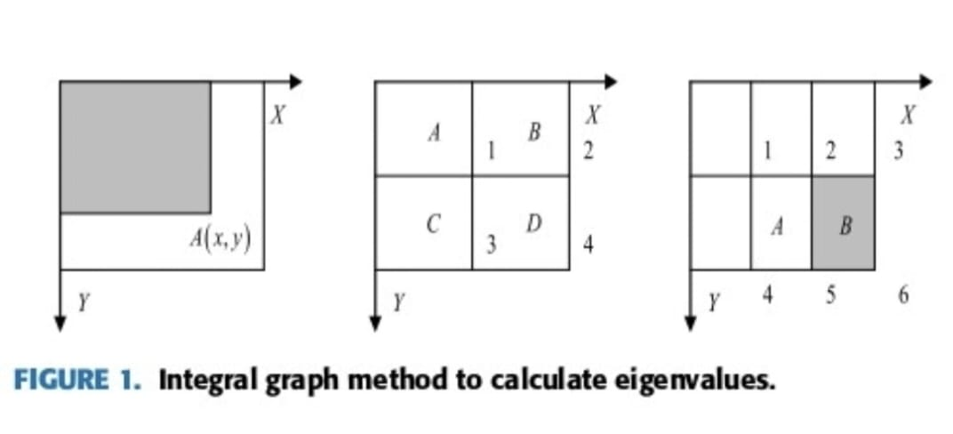
A. FACE DETECTION AND LOCATION:
The integral graph of the coordinate A (x, y) in a graph is defined as sum of all the pixels in its upper left corner.

Slide 26

A. FACE DETECTION AND LOCATION:
Here, ii (x,y) represents the integral image. i (x`,y`) represents the original image; for gray image, here represents the gray value and for color image, here represents the color value. The pixel value of an area can be calculated by using the integral graph of the end points of the area, as shown in above image. The pixel value of region D can be calculated by
where ii (1) represents the pixel value of region A, ii (2) represents the pixel value of region A + B, ii (3) represents the pixel value of region A + C, ii (4) represents the pixel value of regions A + B + C + D. The eigen values of rectangular features can be calculated by integral graphs of feature endpoints. Taking the edge feature a as an example, the eigen value calculation can be expressed by Fig 1 (c).

Slide 27
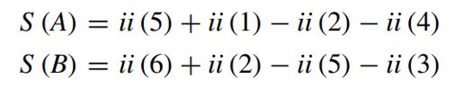
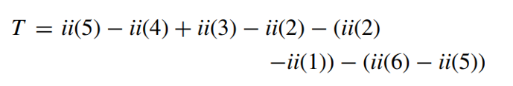
A. FACE DETECTION AND LOCATION:
The pixel values of point A and point B are:
According to the definition, the eigenvalue of rectangular feature is the pixel value of region A minus the pixel value of region B. According to formula (3) and formula (4), the formula for calculating eigenvalue is as follows.
The extracted Haar-like features are used to train the classifier, and the AdaBoost algorithm is used to train the classifier. Finally, the trained classifier is used to extract the face from the image.

Slide 28
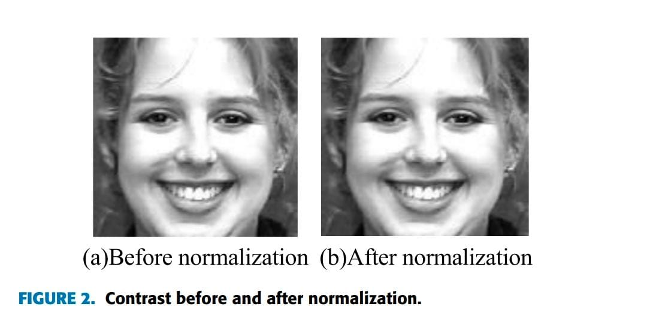
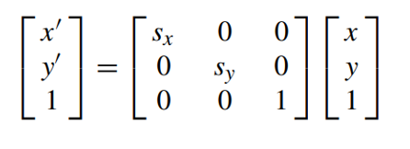
B.SCALE NORMALIZATION:
Because the input of the network is a fixed sized picture, the original picture should be normalized to generate a specific size picture. Through normalization, the input image is scaled to 128 * 128 size. Let point (x, y) in the original picture be normalized and mapped to point (x`, y`). The mapping is as follows:

Slide 29

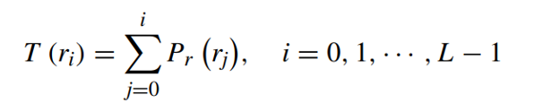
C. GRAY LEVEL EQUALIZATION:
Uneven distribution of light and shade, which will increase the difficulty of feature extraction. Histogram Equalization (HE) method is used to average the gray level to enhance the contrast. It can be simply done by transforming the histogram of the original graph into a uniform distribution form.
If the gray level of the gray image is L, the size is M x N, and the number of pixels in the ri gray level is E, the corresponding probability of gray level occurrence is as follows:
Subsequently, the cumulative distribution function is calculated using the following equation.

Slide 30

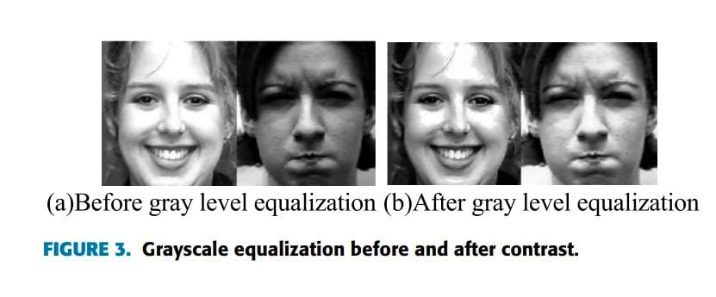
C. GRAY LEVEL EQUALIZATION:
Finally, the image histogram is averaged using the following mapping relations:

Slide 31
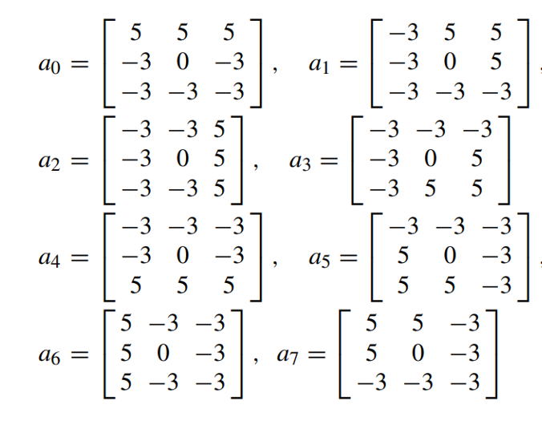
D. IMAGE EDGE DETECTION:
The edge information of an image is often reflected in the area where the gradient information of the image changes dramatically. The edge of the image gives people a stronger visual sense. Kirsch edge operator is used to extract image edge information whose templates are in eight directions.

Slide 32



APPROACH
FACE EXPRESSION RECOGNITION NETWORK MODEL BASED ON CNN:
The CNN is a feedforward neural network, which can extract features from a two-dimensional image and optimize network parameters by using back propagation algorithm.
CNN structure for facial expression recognition

Slide 33
FACE EXPRESSION RECOGNITION NETWORK MODEL BASED ON CNN:
Excluding input layer, the network consists of seven layers, including three convolution layers (C1, C2 and C3), two pooling layers (S1 and S2), one full connection layer and one Softmax layer. The input layer is a 96x96 face pixel matrix. The CNN has three important characteristics: local perception, weight sharing and down sampling. Common sense holds that people’s perception of the outside world is generally from the local to the whole. The adjacent pixels are closely related, while the distant pixels have little correlation. There- fore, neurons only need to perceive the local pixels, and then integrate the local information at the bottom to get the global information at the high level.

Slide 34
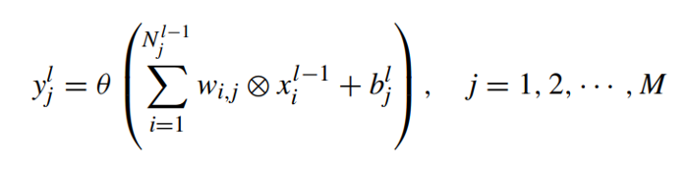

A. CONVOLUTION LAYER:
The convolution layer is the core of CNN, which has the characteristics of local connection and value sharing. The input image and several trainable convolution filters are convoluted to produce the Cl layer of the feature mapping layer. Then the feature mapping map is processed, including summation, weighting and bias operations. Generally the computational expression of convolution layer is
Finally, these feature maps are rasterized and connected into a set of feature vectors, which are then transferred to the neural network classifier for training. Practice has proved that the network trained with ReLU activation function has moderate sparsity. At the same time, it can solve the problem of gradient disappearance.

Slide 35

B. POOLING LAYER:
The main purpose of the pooling operation is to reduce the dimension. If we train the Softmax classifier directly with all the features we have learned, it will inevitably bring about the problem of dimension disaster. So pooling layer is used. A pooling window of 2 x 2 step size can reduce the dimension of the next feature map by half which greatly improves the training speed. The general expression of the pooling is

Slide 36

C. FULL CONNECTION LAYER:
The input of the full connection layer must be a one-dimensional array, whereas the output of the previous pooling layer S2 is a two-dimensional array. First, the two- dimensional array corresponding to each feature graph is converted into a one-dimensional array using Flatten function and then 128 one- dimensional arrays are connected in series to a feature vector of 51200 dimensions (20 x 20 x 128 = 51200) as the full connection.

Slide 37
D.SOFTMAX LAYER:
The last layer of the CNN uses a Softmax classifier. The Softmax classifier is a multi-output competitive classifier. When a given sample is input, each neuron outputs a value between 0 and 1, which represents the probability that the input sample belongs to that class. Therefore, the category corresponding to the neuron with the largest output value is selected as the classification result.

Slide 38
CNN PARAMETER TRAINING:
The training process of CNN is essentially the process of optimizing and updating network weights. Appropriate initialization of weights has a great impact on the updating of weights. The commonly used initialization methods include constant initialization, uniform distribution initialization and Gauss distribution initialization. The training of convolution neural network is divided into two stages:
Forward Propogation:
Sample x is extracted from the training sample set. Its corresponding category label is y, y is a 7-dimensional vector whose elements represent the probability that x is divided into different categories. The output of the upper layer is the input of the current layer. Then, the output of the current layer is calculated by activation function, which is passed down layer by layer.
Back Propogation:
Calculate the error between the output y˜ of Softmax layer and the class label vector y of a given sample, and adjust the weight parameters by minimizing the mean square error cost function.

Slide 39
REFERENCES
[1] https://ieeexplore.ieee.org/stamp/stamp.jsp?tp=&arnumber=8884205
[2] H. Zhang, A. Jolfaei and M. Alazab, "A Face Emotion Recognition Method Using Convolutional Neural Network and Image Edge Computing," in IEEE Access, vol. 7, pp. 159081-159089, 2019, doi: 10.1109/ACCESS.2019.2949741.
[3] R. M. Mehmood, R. Du, and H. J. Lee, ‘‘Optimal feature selection and deep learning ensembles method for emotion recognition from human brain EEG sensors,’’ IEEE Access, vol. 5, pp. 14797–14806, 2017.
[4] T. Song, W. Zheng, C. Lu, Y. Zong, X. Zhang, and Z. Cui, ‘‘MPED: A multi-modal physiological emotion database for discrete emotion recognition,’’ IEEE Access, vol. 7, pp. 12177–12191, 2019.
[5] E. Batbaatar, M. Li, and K. H. Ryu, ‘‘Semantic-emotion neural network for emotion recognition from text,’’ IEEE Access, vol. 7, pp. 111866–111878, 2019.
[6] H. Meng, N. Bianchi-Berthouze, Y. Deng, J. Cheng, and J. P. Cosmas, ‘‘Time-delay neural network for continuous emotional dimension prediction from facial expression sequences,’’ IEEE Trans. Cybern., vol. 46, no. 4, pp. 916–929, Apr. 2016.

Slide 40
THANK YOU

